Slide 1
Power BI Financial Analyst
About the Instructor
About AI Sciences
Descriptive Course Outline
Shahzaib Hamid
AI Sciences Instructor

Slide 2
Instructor
Shahzaib Hamid, Ph.D. Scholar
7 Years in Academia and Industry
AI Consultant
Lecturer, Superior University Lahore, Pakistan
Vast Experience in Multiple AI based R&D Fields
R&D Interests Include, Data Science & Analysis, Computer Vision, NLP, Reinforcement Learning, Applied Machine Learning and Data Engineering in Industry Oriented Problem Solving

Slide 3
AI Sciences
Group of Ph.Ds. and AI practitioners
More than 40000 students on Udemy
More than 80% courses have +4.5 rating
Prepare you to solve digital problems
Courses dedicated to beginners and new commers
Core Focus: Machine Learning, Artificial Intelligence, Statistics and Data Science

Slide 4

In this Course
Power BI Desktop
Analyzing Sales
Visualization
Prepare P&L
Analyze P&L
Introduction
Importance
Resources
Calculation
Matrix Formatting
Visualize Sales trends
Adding Slicers
Calculate Profits
KPI for visualization
Data Slicer
Charts for P&L
Comparison for P&L
Analysis

Slide 5
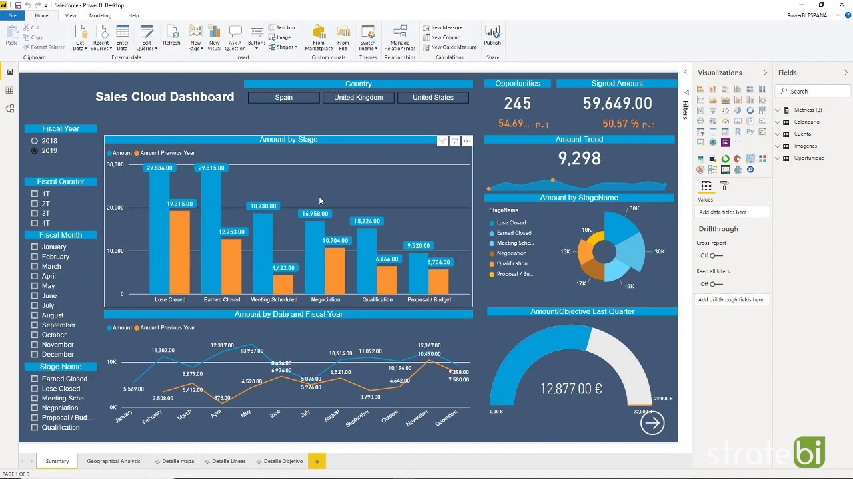
Financial Analysis case-study
Develop a financial analysis case-study with Power BI
Installing Power BI
Getting data into Power BI
Sales Analysis using multiple techniques
Preparing P&L
Analysis of P&L through visuals
Comparison analysis

